Slide 1
Reinforcement Learning for Energy-Efficient Residential Heating Control
Presenter: Ruxiao Chen

Slide 2
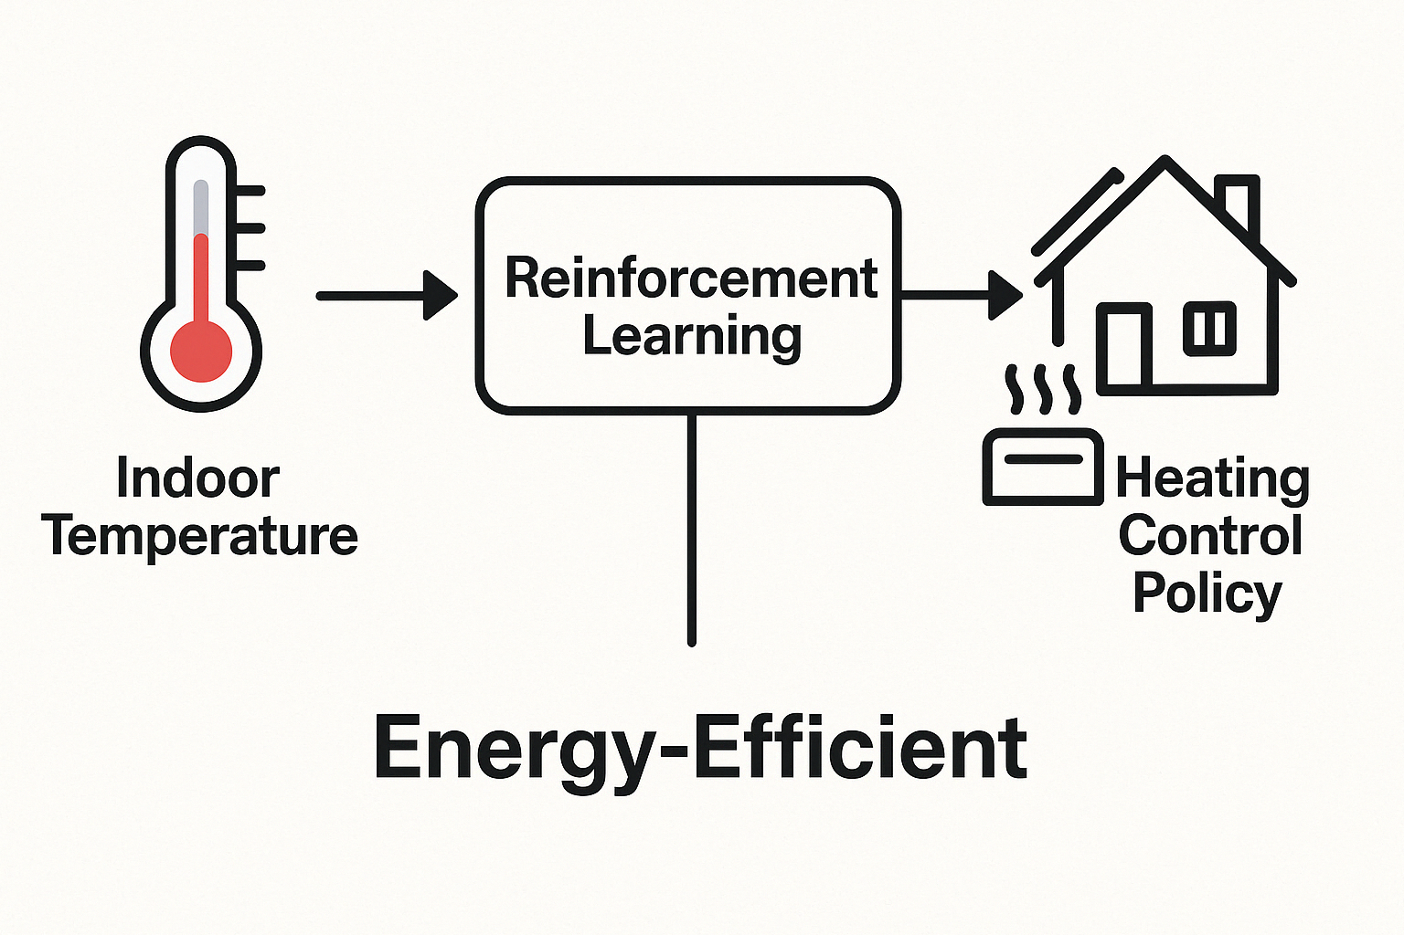
Background: Problem statement and motivation
Problem Statement:
The project aims to learn an optimal heating control policy (output) from indoor temperature data (input) to maintain comfort while minimizing energy use (goal).

Slide 3
Background: Literature Review and Limitations of Existing Methods
Classic Approach: Model Predictive Control (MPC)
Widely used in residential heating control. Relies on a detailed thermal model to predict temperature changes. Optimizes heating actions over a fixed future horizon.
High modeling cost: Requires building-specific parameters (e.g., insulation, materials, occupancy).
Poor scalability: Each home needs its own calibrated model. Performance drops if the environment deviates from the model assumptions.
Computationally expensive: Solving optimization problems in real time is not practical for every home.
Limitations of MPC

Slide 4
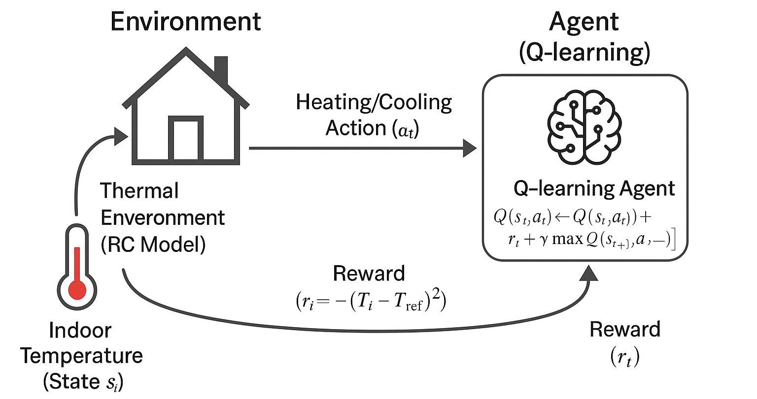
Proposed Method: Reinforcement Learning for Heating Control
Model-Free Learning Learns control policy directly from interaction with the environment — no need for physical modeling.
Adaptability Automatically adapts to different building dynamics and external conditions.
Lightweight & Scalable Once trained, the learned policy is computationally efficient and easy to deploy.
Objective Maintain indoor comfort near 22°C while minimizing energy usage.
One sentence quick explain:
Q-learning method Learns the optimal action-selection policy iteratively based on the rewards received from interacting with the environment.

Slide 5
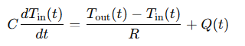
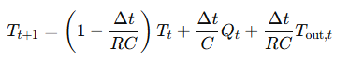
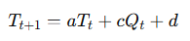
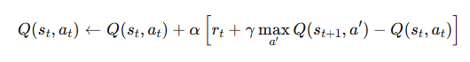
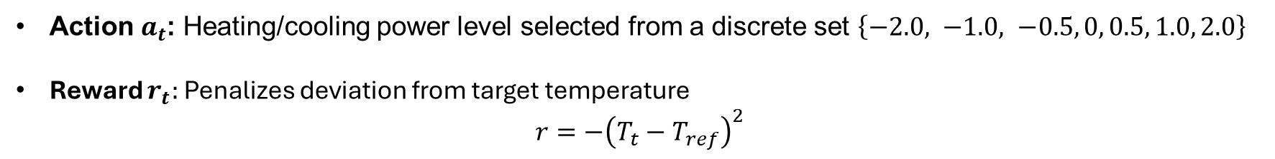
Formulation: Reinforcement Learning for Heating Control
State $s_{t}$: Discretized indoor temperature at time t.
Original RC heat model
Discrete Form
Simplified Form
In current setup, we set a= 0.9, c=0.5, d=3.0
Action $a_{t}$: Heating/cooling power level selected from a discrete set $\left\{−2.0, −1.0, −0.5, 0, 0.5, 1.0, 2.0\right\}$
Reward $r_{t}:$Penalizes deviation from target temperature
$$r=−{\left(T_{t}−T_{ref}\right)}^{2}$$
Q-Value Update Rule:
It adjusts the current Q-value toward a better estimate that includes both the immediate reward and the best possible future reward.

Slide 6
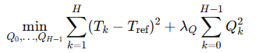
Baseline Method: Model Predictive Control
What is MPC? An optimization-based control strategy that uses a predictive model to plan control actions over a finite time horizon.
How it works:
predicts future temperatures using the system model
solves an optimization problem to determine control action sequence
Only applied first action in the optimized sequence
MPC Formulation:
Subject to:

Slide 7
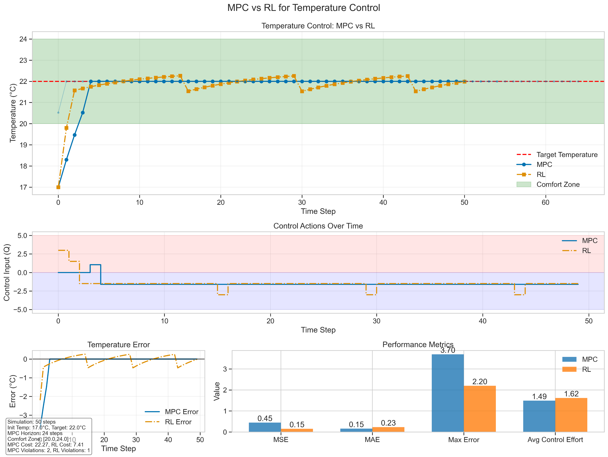

Experiment 1: Comparison of performance in same, single setting
In this setup, we set a= 0.9, c=0.5, d=3.0, and implement both methods to check their performances

Slide 8
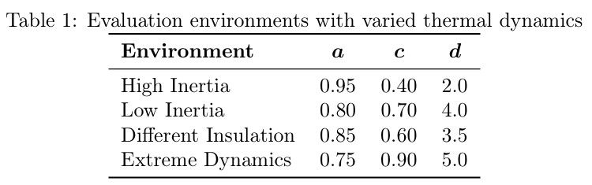
Experiment 2: Model Transfer Ability Evaluation
This experiment evaluates whether a policy trained in one room ("Original Room") can be directly transferred to other rooms with different dynamics — without retraining.
High Inertia: higher a, meaning slower temperature response to control actions.
Low Inertia: lower a, leading to rapid and potentially unstable temperature changes.
Different Insulation: Modified resistance and capacitance (c and d), simulating altered heat loss and gain characteristics.
Extreme Dynamics: Large deviations in all parameters, representing a highly mismatched and challenging deployment scenario.

Slide 9
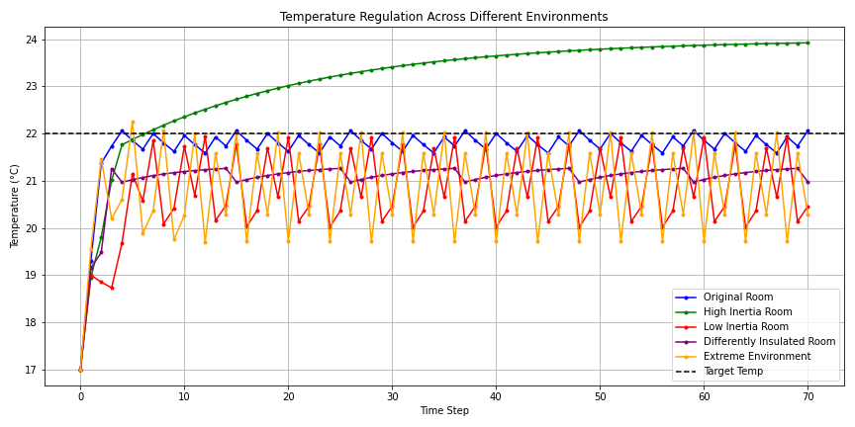
Experiment 2: Model Transfer Ability Evaluation

Slide 10
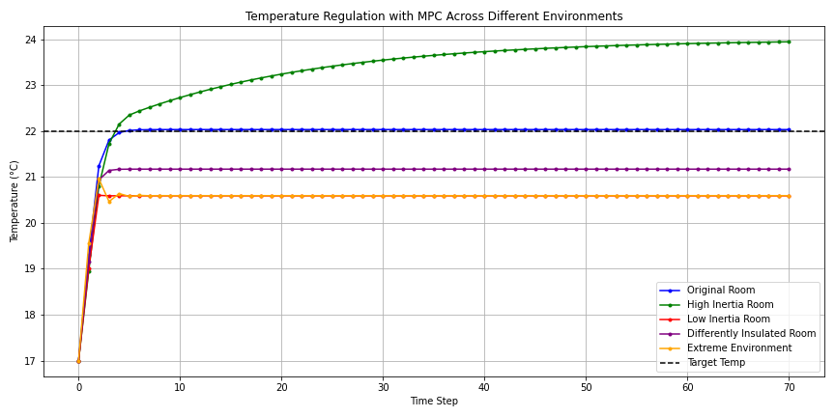
Experiment 2: Model Transfer Ability Evaluation

Slide 11
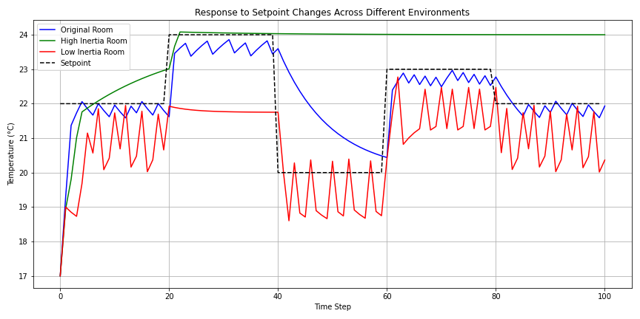
Experiment 2: Model Transfer Ability Evaluation

Slide 12
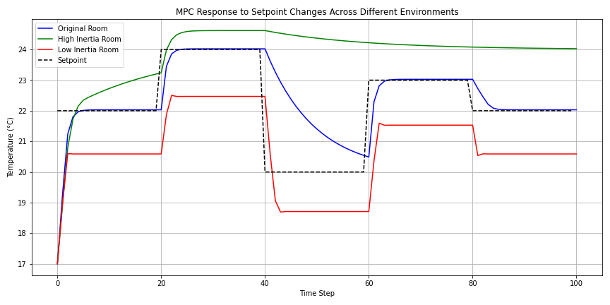
Experiment 2: Model Transfer Ability Evaluation

